Slide 1
The Conceptual Architecture of Apollo Platform
URL： https://youtu.be/LCWyr6lRCL0
CISC322 22W

Slide 2
The Conceptual Architecture of Apollo Platform
Group Leader: Hairuo Li
Slides Maker: Jialing Gong
Presentation: Muyun Sai
Report Maker:Yuxuan Yang/Jialing Gong/Muyun Sai
Yuxin Huang/Hairuo Li/Songyu Yang
CISC322 22W

Slide 3
Apollo Platform
WHAT
a high performance, flexible architecture
WHY
to accelerate the development, testing, and deployment of Autonomous

Slide 4
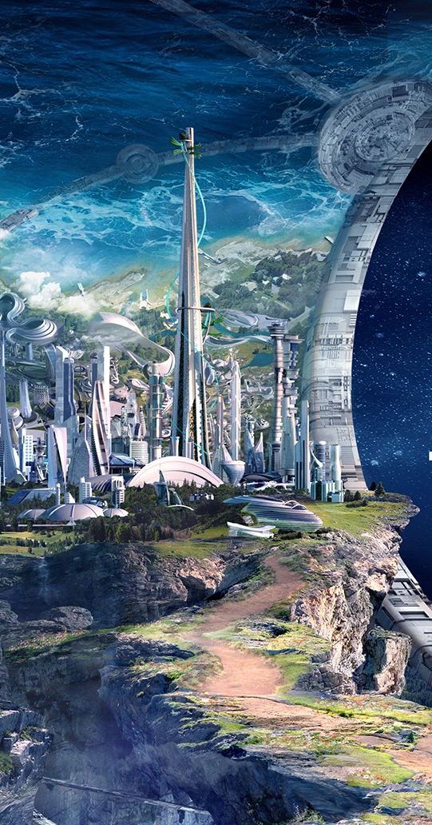
CONTENT
Functionality and Interaction
4
1
1
1
Concurrency
2
The Evolvement for System
5
1
1
Responsiblity
3
Control And Data Flow
6
1
1
Conclusion

Slide 5
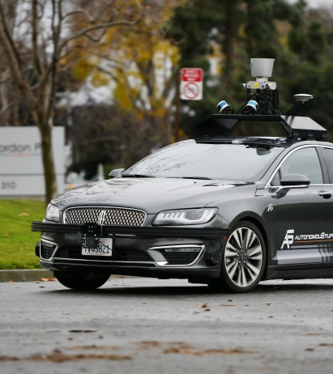
01
Functionality and Interaction

Slide 6
Apollo Platform
Localization
Simulation
Perception
Hardware
Planning
HMI
Control
Software

Slide 7
Apollo Platform
obstacle perception and traffic light perception are divided into two or one sub-component.
Software:
Perception
Planning
evaluates behavioral trajectories and motion logic of autonomous vehicles based on the traffic condition corresponding to collection of data.
monitor the motion of the vehicle with capability of braking, changing direction and improving traction control to handle some of the different road conditions.
Control

Slide 8
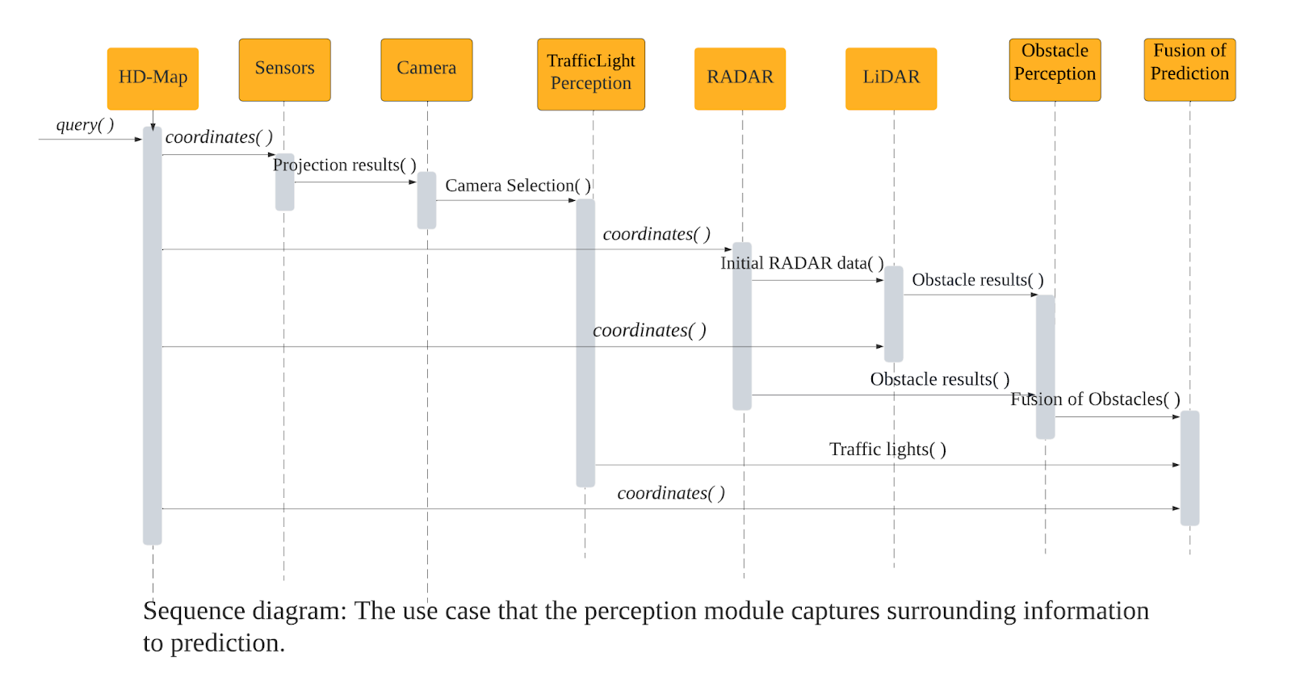
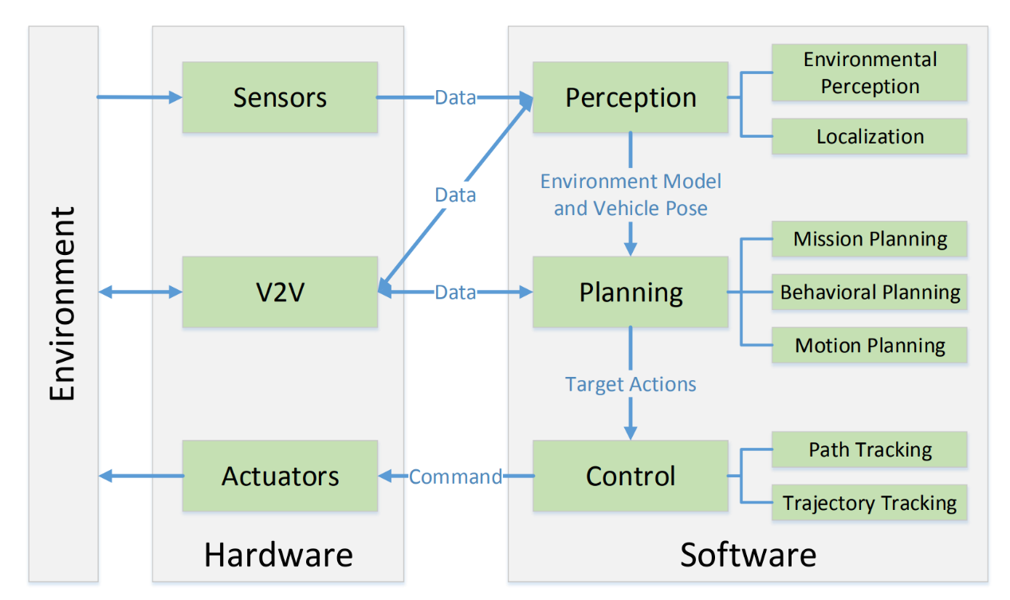
Apollo Platform
Software
Hardware
Transfers data from sensors to perception systems.

Slide 9
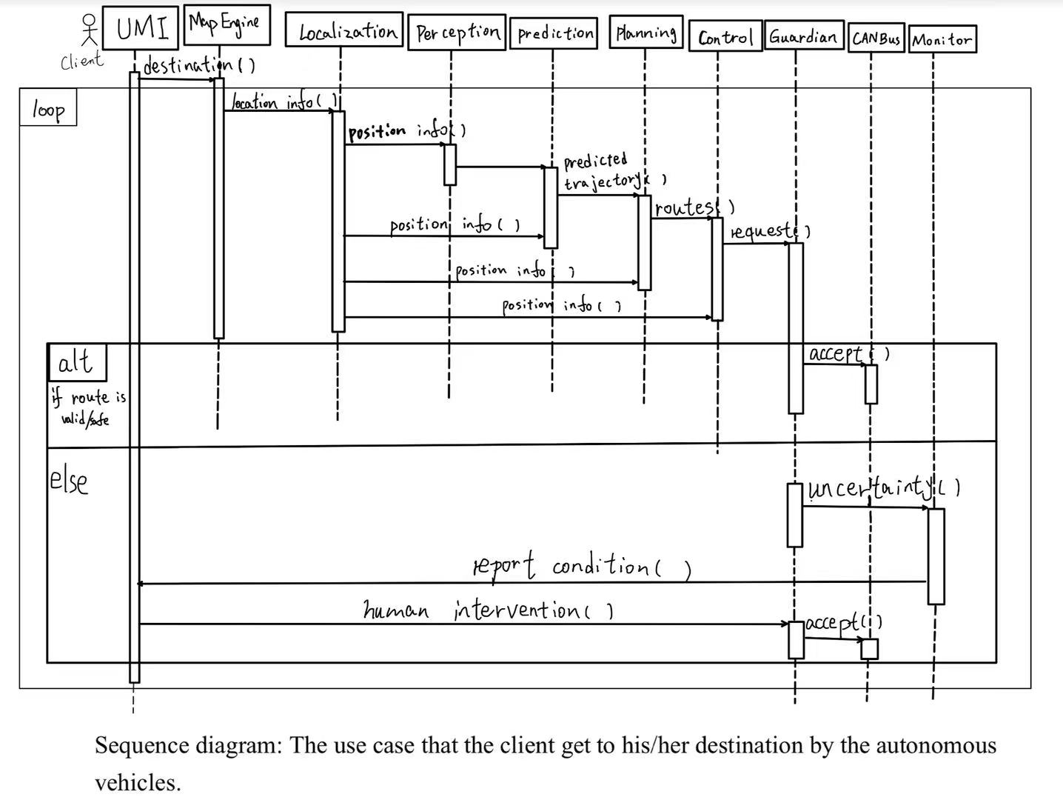
Apollo Platform
Hardware
Software

Slide 10
02
The Evolvement for System

Slide 11

1.0
2017.7
Closed Venue AD
1.5
2017.10
Fixed Lane AD
2018.1
AD on Simple Urban Road
2.0
HELLO
2.5
2018.4
Geo-fenced Highway AD
3.0
2018.7
Production-level Closed Venue AD
APOLLO
3.5
2019.1
City Urban Road AD
APOLLO PLATFORM ANNOUNCED
2017.4
5.0
2019.7
AD Empowering Production
5.5
2019.12
Curb-to-Curb Urban Road AD
6.0
2010.9
Towards Driverless Drving
automatically detect the surrounding environment
7.0
NOW
avoid obstacles in time

Slide 12
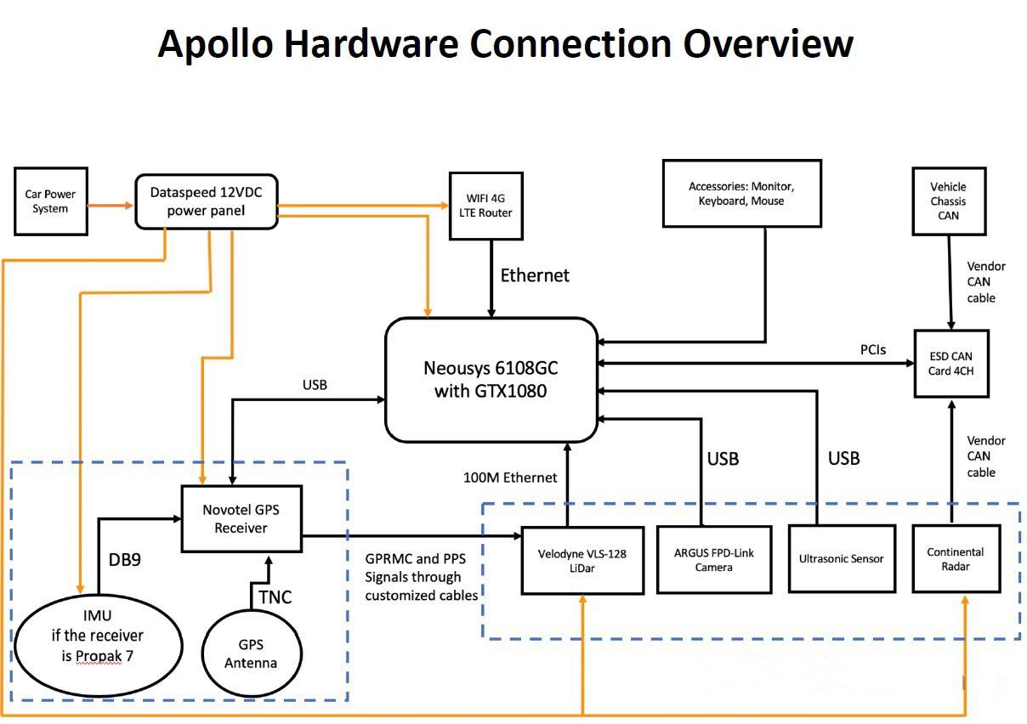
Apollo Platform

Slide 13



navigation module (IMU)
perform the positioning operation and generates the position data of the relative map together with the output data of the perception module (scanning result of Lidar).
be directly provided to the path planning module (planning) for decision-making
control the "prediction module" (prediction) to predict the possible action trend changes near various moving and static targets.
Guardian module +

Slide 14
03
Control And Data Flow

Slide 15
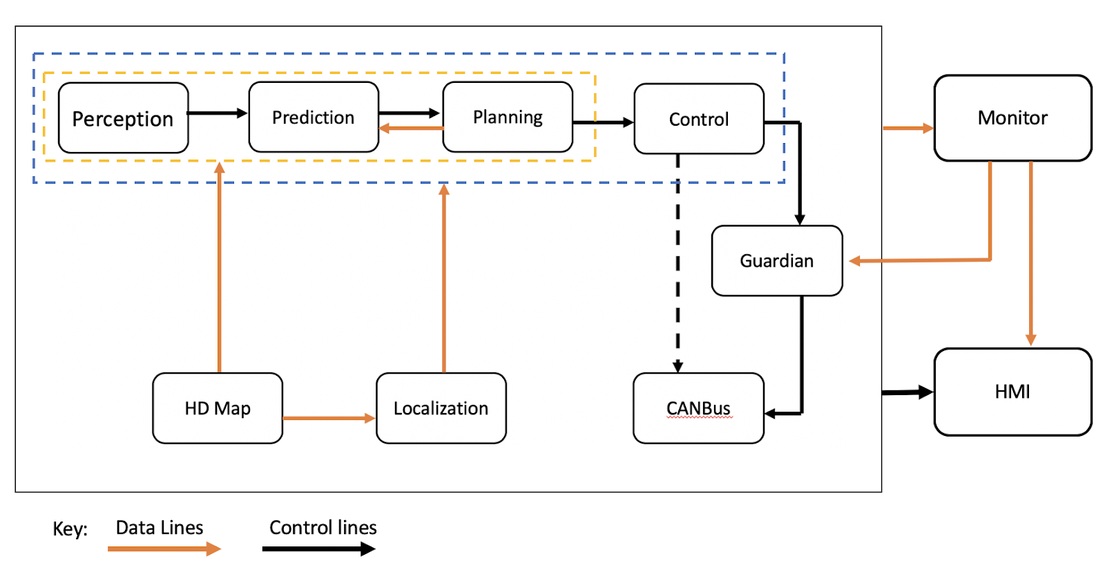
Apollo Platform

Slide 16

Apollo Platform
Perception
Control
01
when the car meets a traffic light which is red:
04
distance to this cross
the color of traffic light
change the plan to car language for executing
Localization
Guardian
02
05
speed, car gear information
check if there exist any problem
Planning
CANBus
03
06
how to slow the car smoothly and feasible then stop, give back to to the prediction
get the instruction then execute

Slide 17
04
Concurrency

Slide 18
Apollo Platform
Models
on a real-time operating system
requires
running multiple processes concurrently,
such as
01
carry multiple computers, each used to control part of the robot's drives or sensors.
Concurrency
Communication
Priority
Resource
building
02
03
multi-node
divide the program into smaller modules that run independently and collaborate to accomplish complex control tasks
When work together, they often need to communicate with each other to support the completion of the task.
Ditributed Computing
Cyber

Slide 19

Why Concurrency
Case: service station closed
based on situation like
driving emergencies, dynamic changes in the external environment, or user command operations
receiving information
involves the timeliness of judgments and user safety
need to process information and complete communication in an instant.
notifying the change
controlling on the new route

Slide 20
05
Responsibilities of Participating Developers

Slide 21
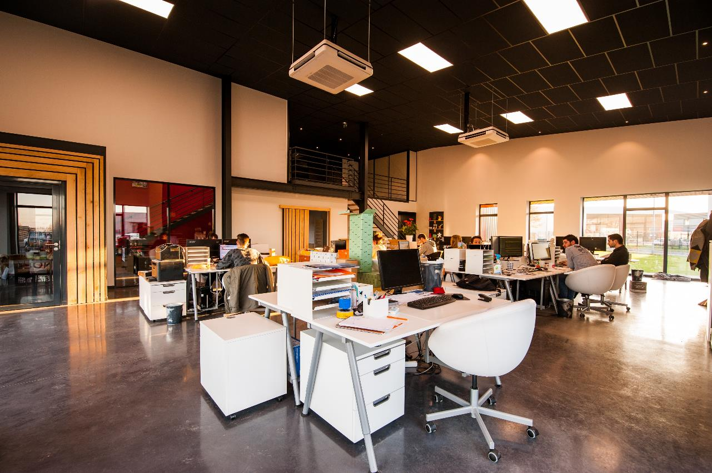
Apollo Platform
Developers
Platfotm
Cloud Service Platform
Hardware Development Platform
technical programmers
Project Manager
Architecture Analyst
System Analyst
Data-Base Administrator
C
H
01
02
O
O
Open Software Platform
Open Vehicle Certificate Platform

Slide 22




Apollo Platform
Responsibility
Design various interfaces for data transmission and modify the source code to different developers in the open-source community
Keep updating or expanding the development environment
Implement their own software or update the dataset

Slide 23
06
Conclusion

Slide 24

Now is able to...
However,
powerful computing and processing capabilities
a variety of radars and cameras throughout the body of car
Complete most of the autopilot functions
not perfect and not reliable enough
more developers and researchers are needed to continuously study, update and maintain its functions

Slide 25

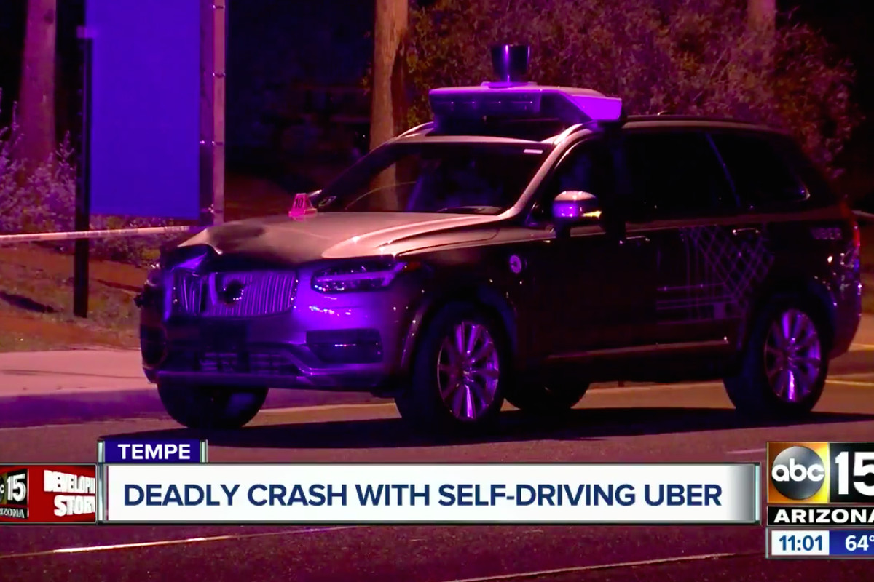
Lessons Learned:
threats, and hidden dangers
evening of March 18, 2018 Tempe, Arizona
“Uber vehicle during a self-driving test crashed into a pedestrian“
first case in history of AV crash
current automatic driving system is not perfect and there are many safety hazards.

Slide 26
THANK FOR EVERYONE

Slide 27
Apollo Platform
Reference
[1] Qiaochu Guo(April 29, 2020). Software System of Autonomous Vehicles: Architecture, Network and OS.
[2] P. Penmetsa; E. Kofi Adanu; D. Wood; T. Wang; S. L.Jones(June 2019). doi: https://doi.org/10.1016/j.techfore.2019.02.010
[3] https://apollo.auto/platform/perception.html
[4] Dhanoop Karunakaran(Nov 25, 2020). Motion planning module in Autonomous Vehicle — Mission planner. doi: https://medium.com/intro-to-artificial-intelligence/motion-planning-module-in-autonomous-vehicle-mission-planner-671b2155dec1
[5] P. Falcone; F. Borrelli; J. Asgari; H. Eric Tseng; D. Hrovat; Fellow (MAY 2007). Predictive Active Steering Control for Autonomous Vehicle Systems.
[6] S. Drew Pendleton; H. Andersen; Xinxin Du; Xiaotong Shen; M. Meghjani; You Hong Eng; D. Rus; M. H. Ang Jr (17 February 2017). Perception, Planning, Control, and Coordination for Autonomous Vehicles.
[7] Maggie Weeks(May 28, 2019). Autonomous Driving and the Need For Motion Planning. doi: https://rtr.ai/autonomous-driving-and-the-need-for-motion-planning/
[8] https://blog.csdn.net/qq_45577461/article/details/107451042
[9] GitHub - ApolloAuto/apollo: An open autonomous driving platform
[10] https://zhuanlan.zhihu.com/p/62259081
[11] https://en.wikipedia.org/wiki/Concurrent_computing
[12] https://apollo.auto/devcenter/devcenter.html
[13] Eric Walz(May 27, 2020). China's Baidu Completes its ‘Apollo Park’, the World's Largest Autonomous Driving & Intelligent Vehicle Testing Site. doi: https://www.futurecar.com/3946/Chinas-Baidu-Completes-its-Apollo-Park-the-Worlds-Largest-Autonomous-Driving-&amp;-Intelligent-Vehicle-Testing-Site
[14]Apollo Auto (Oct 10, 2020). Inside Apollo 6.0: A Road Towards Fully Driverless Technology. doi: https://medium.com/apollo-auto/inside-apollo-6-0-a-road-towards-fully-driverless-technology-522b2b4295cc

